Slide 1

Capstone Project – 1
Hotel Booking Analysis Rohit Madame

Slide 2
Content
Importing dataset and loading data of hotel booking.
Data cleaning
Data preparation
Data Visualization
Conclusion

Slide 3
Data Summary
Hotel Booking data contains the information from the year 2015 to 2017.The shape of this data set is 119390 rows and 32 columns.
Data Description
hotel :Resort Hotel or City Hotel
is_canceled : Value indicating if the booking was canceled (1) or not (0)
lead_time : Number of days that elapsed between the entering date of the booking and the arrival date
arrival_date_year : Year of arrival date
arrival_date_month : Month of arrival date
arrival_date_week_number : Week number of year for arrival date
arrival_date_day_of_month : Day of arrival date
stays_in_weekend_nights : Number of weekend nights
stays_in_week_nights : Number of week nights.
adults : Number of adults
children : Number of children
babies : Number of babies
meal : Type of meal booked.
country : Country of origin.

Slide 4
Data Description
market_segment : Market segment designation. (TA/TO)
distribution_channel : Booking distribution channel.(T/A/TO)
is_repeated_guest : is a repeated guest (1) or not (0)
previous_cancellations : Number of previous bookings that were cancelled by the customer prior to the current
booking
previous_bookings_not_canceled : Number of previous bookings not cancelled by the customer prior to the
current booking
reserved_room_type : Code of room type reserved.
assigned_room_type : Code for the type of room assigned to the booking.
booking_changes : Number of changes made to the booking from the moment the booking was entered on the
PMS until the moment of check-in or cancellation
deposit_type : No Deposit, Non Refund , Refundable.
agent : ID of the travel agency that made the booking
company : ID of the company/entity that made the booking .
days_in_waiting_list : Number of days the booking was in the waiting list before it was confirmed to the customer
customer_type : type of customer. Contract,Group,transient,Transient party.
adr : Average Daily Rate as defined by dividing the sum of all lodging transactions by the total number of staying
nights
required_car_parking_spaces : Number of car parking spaces required by the customer
total_of_special_requests : Number of special requests made by the customer (e.g. twin bed or high floor)
reservation_status : Reservation last status.

Slide 5
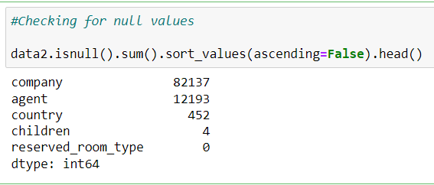
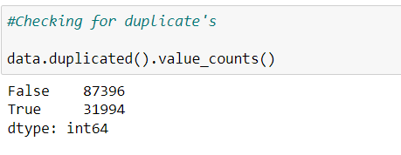
Data Cleaning
As we have seen the data it contains null values in 4 columns i.e company,agent,country,children.
Data contains some duplicate values.so we have to drop it.

Slide 6
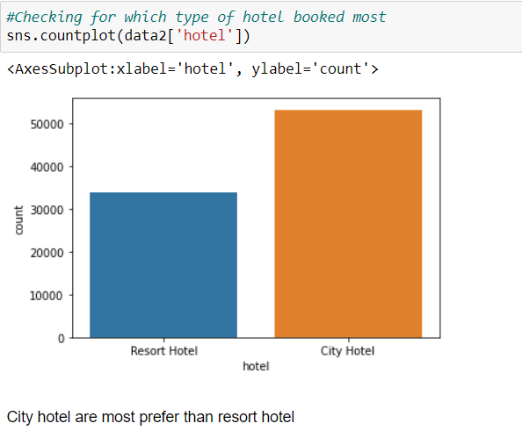
Data Visualization

Slide 7
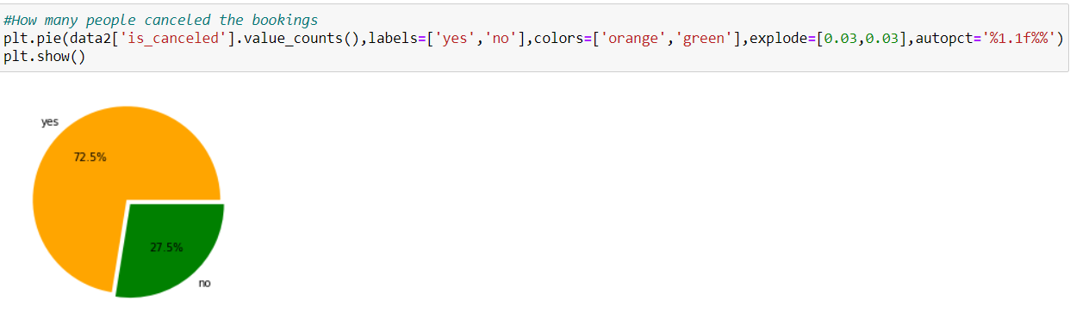
Is hotel booking canceled

Slide 8
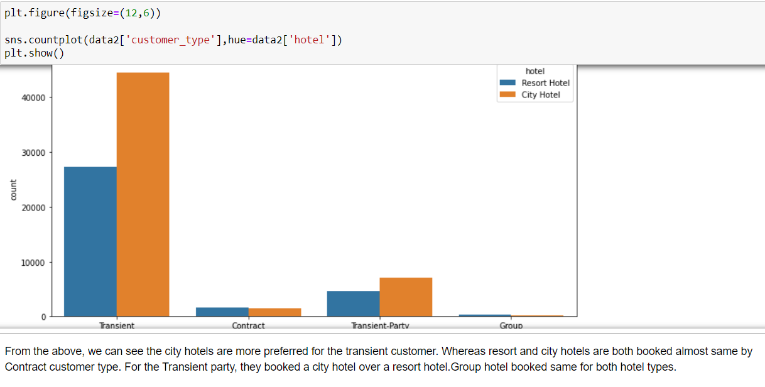
Which hotel does customer like

Slide 9
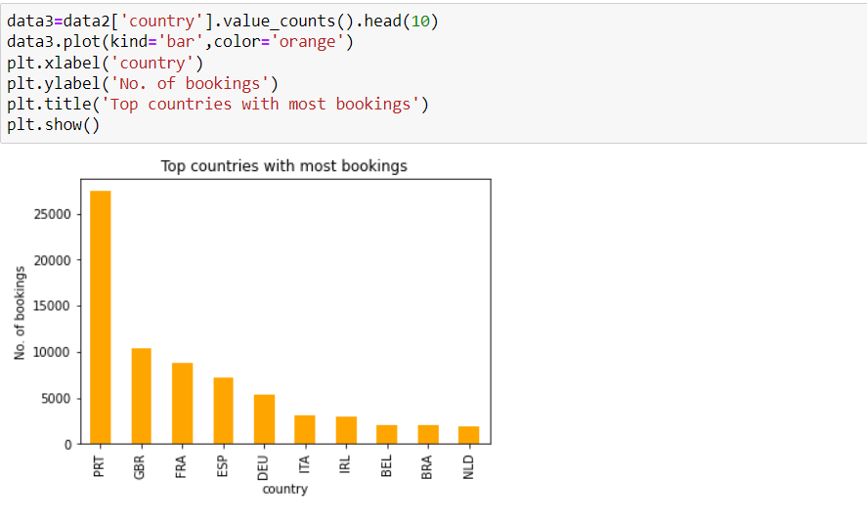
Top countries with most bookings

Slide 10
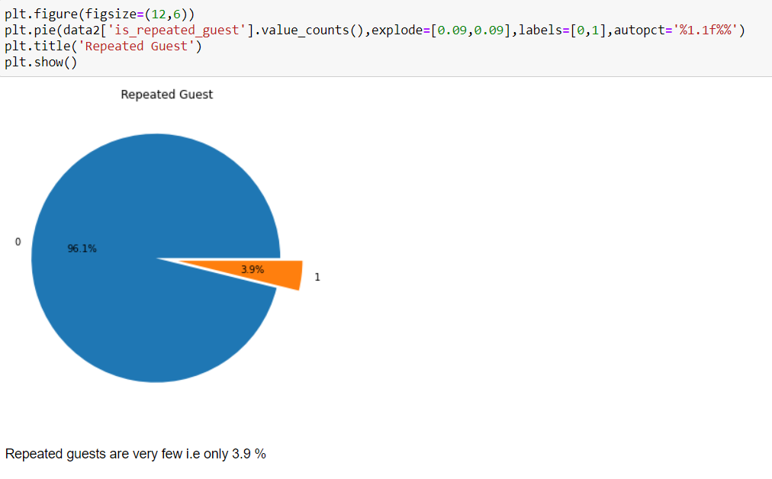
How many times did the guest repeat

Slide 11
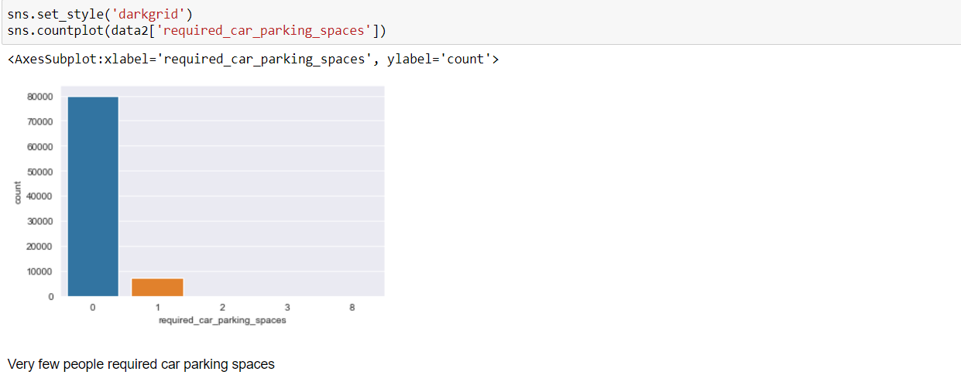
Required car parking spaces

Slide 12
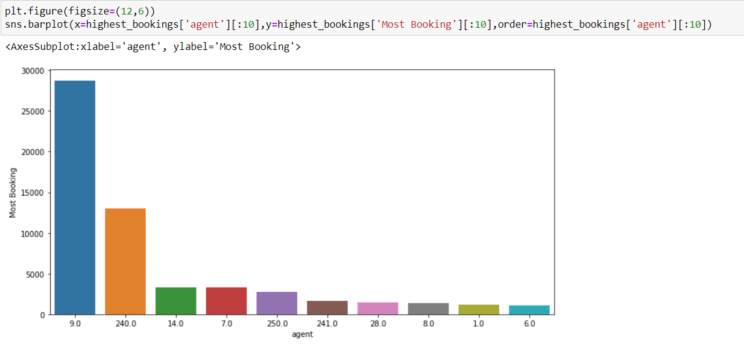
Which agent has most bookings

Slide 13
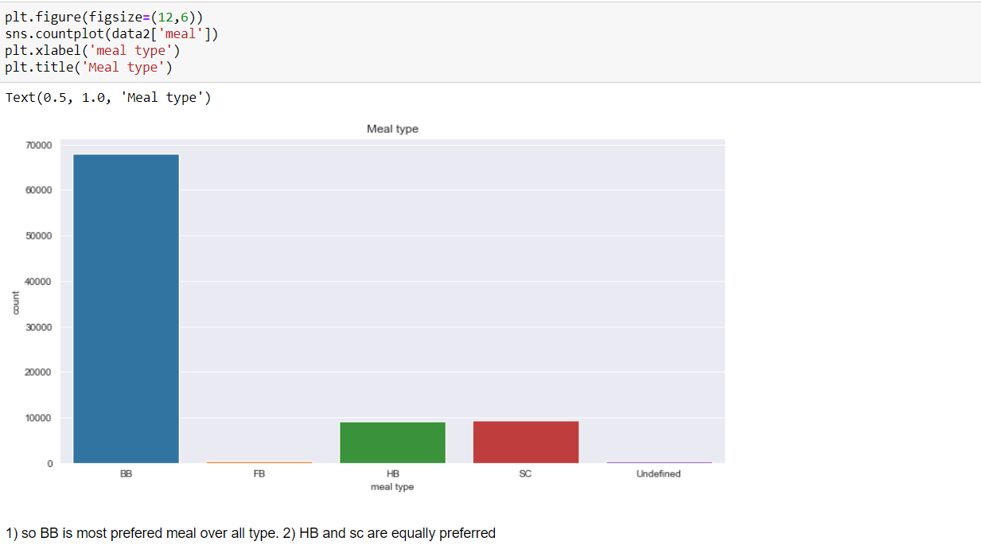
Type of meal is preferred by the customer

Slide 14
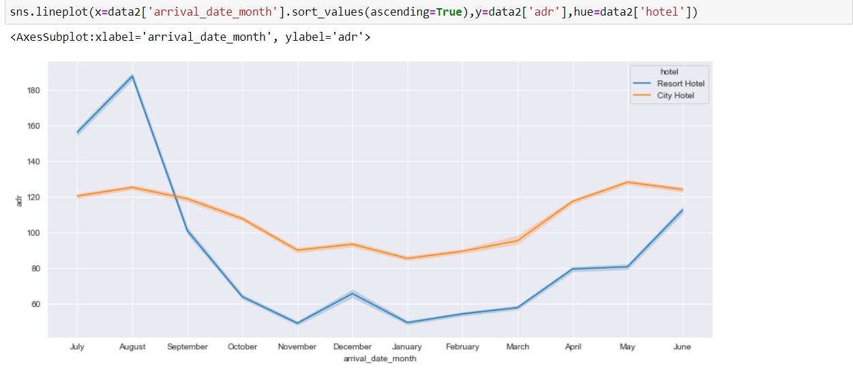
ADR across each month

Slide 15
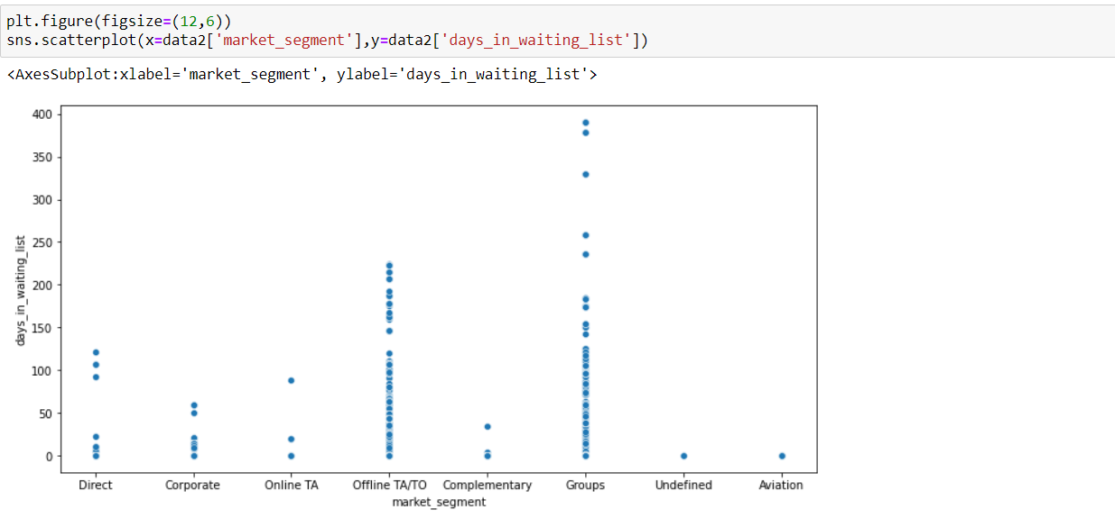
Market segment and waiting list for booking

Slide 16
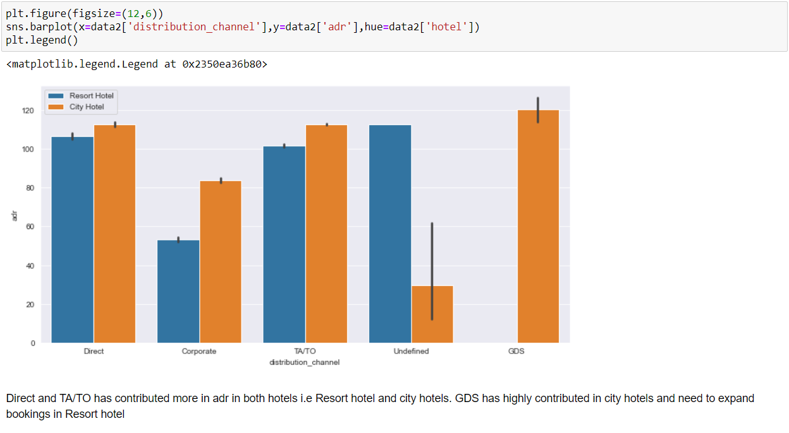
Which distribution channel contributed more in adr

Slide 17
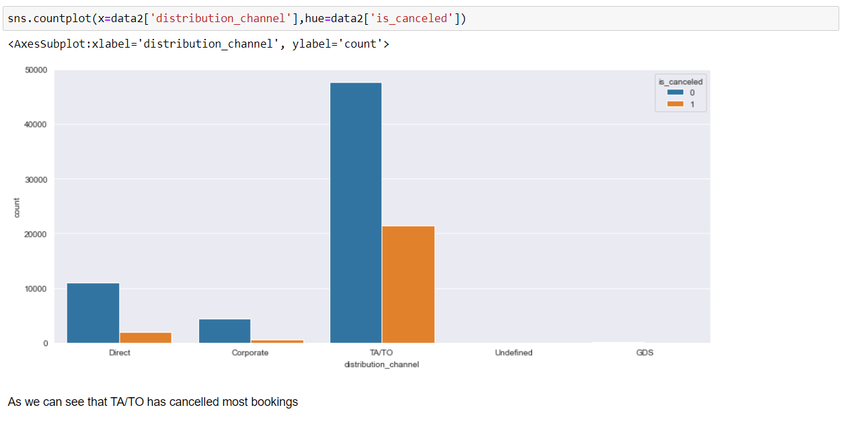
Cancelation ratio for distribution channel

Slide 18
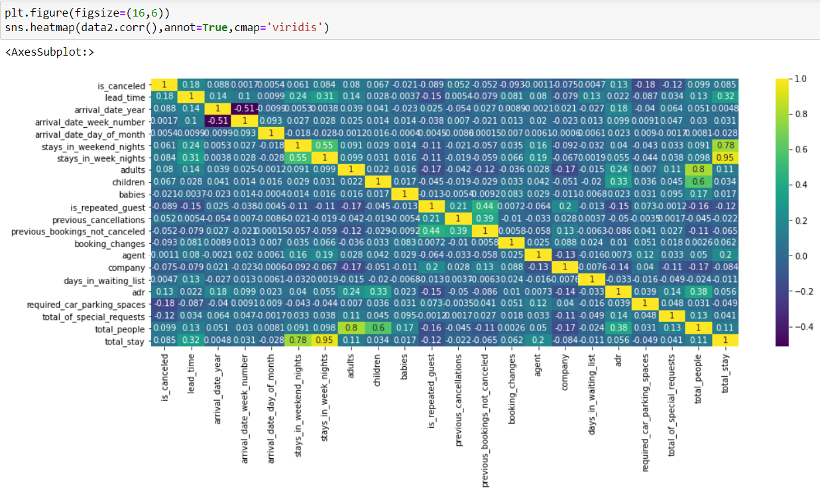
Relation between variables

Slide 19
Challenges
Duplicate data is about 26.8 %
Data set Contains null values.
Many rows have similar data.

Slide 20
Conclusion
Booking for city hotels is more than resort hotels.
New guests are more as compared to a repeated guest.
Most people don’t need car parking. Few want parking for one car only.
ADR is highest for august and july month
BB is most preferred meal
Agent number 9 has most bookings.

Slide 21
Thank You!

